Slide 1
ML : 17.01.19
Regression
Perceptron
SVM

Slide 4
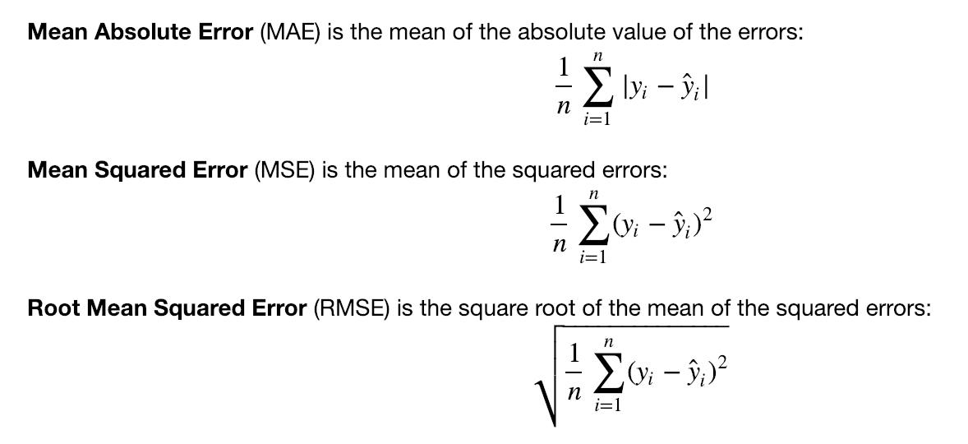

Slide 6
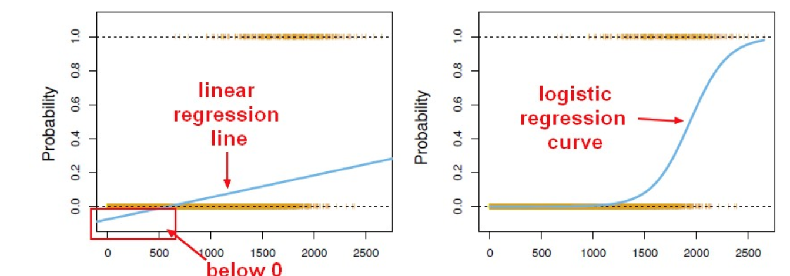

Slide 8
Algorithm | Problem Type
KNN | Either
Linear regression | Regression
Logistic regression | Classification
Naive Bayes | Classification
Decision trees | Either
Random Forests | Either
AdaBoost | Either
Neural networks | Either

Slide 9
https://www.dataschool.io/comparing-supervised-learning-algorithms/
Problem Type
Results interpretable by you?
Easy to explain algorithm to others?
Average predictive accuracy
Training speed
Prediction speed
Amount of parameter tuning needed (excluding feature selection)
Performs well with small number of observations?
Handles lots of irrelevant features well (separates signal from noise)?
Automatically learns feature interactions?
Gives calibrated probabilities of class membership?
Parametric?
Features might need scaling?

Slide 10
A perceptron is a simple model of a biological neuron in an artificial neural network. Perceptron is also the name of an early algorithm for supervised learning of binary classifiers

Slide 11
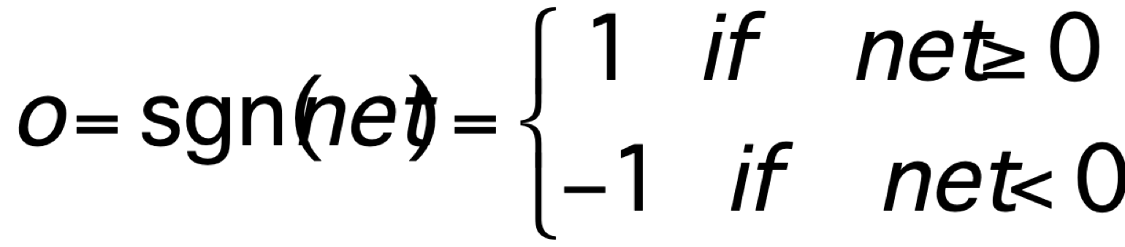
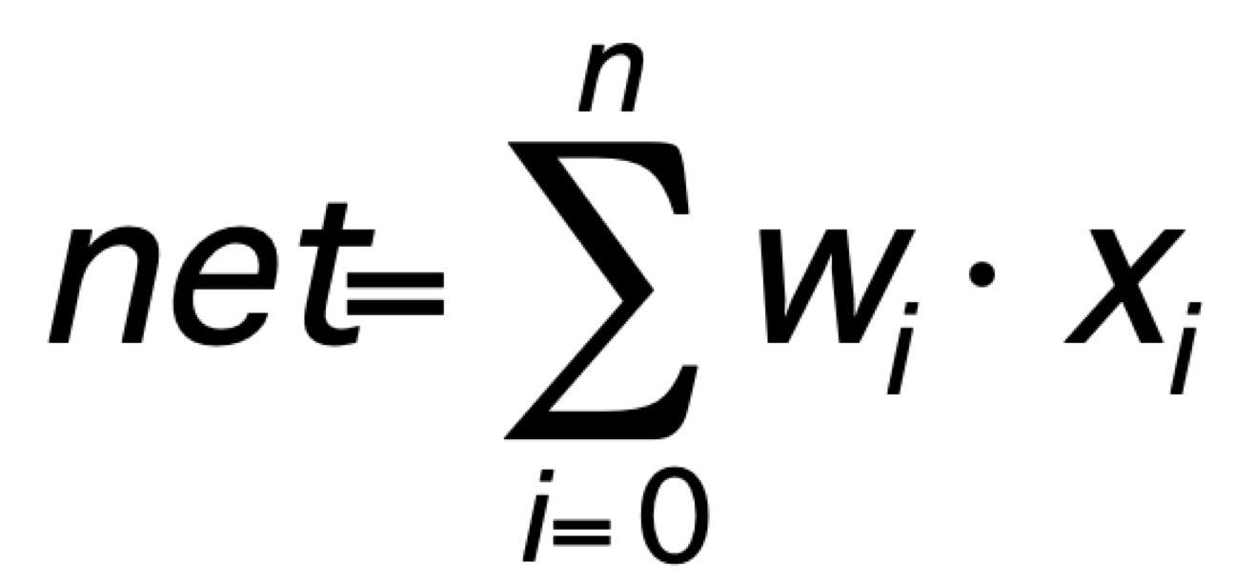
Perceptron
Linear treshold unit (LTU)
x₀₌₁
x₁
w₁
w₀
w₂
x₂
Σ
o
.
.
.
w_{n}
x_{n}
McCulloch-Pitts model of a neuron

Slide 12
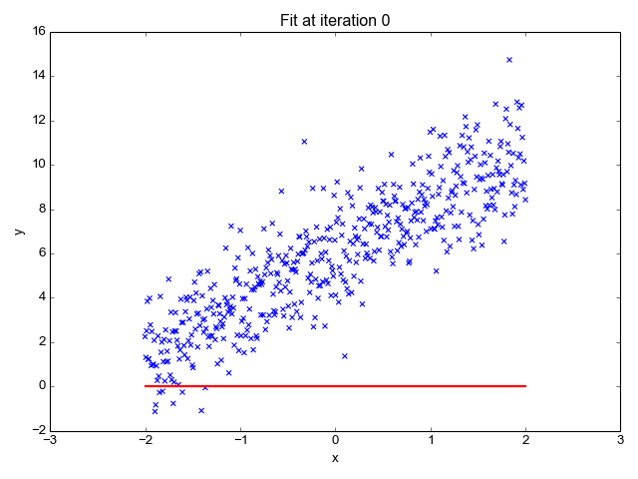

Slide 13
SVM
https://www.youtube.com/watch?v=_PwhiWxHK8o

Slide 14
** : When we got struck with an algo/accuracy just change it

Slide 15
Datasets & Links
http://www.lock5stat.com/datapage.html
https://archive.ics.uci.edu/ml/index.php
https://www.kaggle.com/datasets
https://www.listendata.com/2014/11/difference-between-linear-regression.html

